Slide 1
Travel Data Summary
Joshua Noorily, Sari Prince, Navneet Sunderraman, Emily Overall

Slide 2
Introduction | Major Findings
Customer Preferences:
Fishing by far more popular than hunting: fishing (82.9%) compared to hunting (17.1%).
Saltwater fishing trips were the most popular, but freshwater (other) trips earned the most in commissions and land sales.
The most frequently visited destination was Ponoi in Russia.
Argentina was the most visited Country.
75% of the trips lasted 8 days or less.
Top 3 Highest Commission Country/Destination:
Country: England, New Zealand, Denmark
Destination: England WS, New Zealand, Tsimané
Top 3 Highest Land Sales Country with Trip Type:
Country: England, Denmark, Paraguay
Trip Type: Wing Shooting
Highest Commission Trip Types: Freshwater (Other) and Wing Shooting
Booking Patterns/Seasonal Trends
63% of all trips start between May and September.
47% of all trips are booked between October and December
Customer Churn:
98% of customers do not return to book with the Travel Agency.

Slide 3
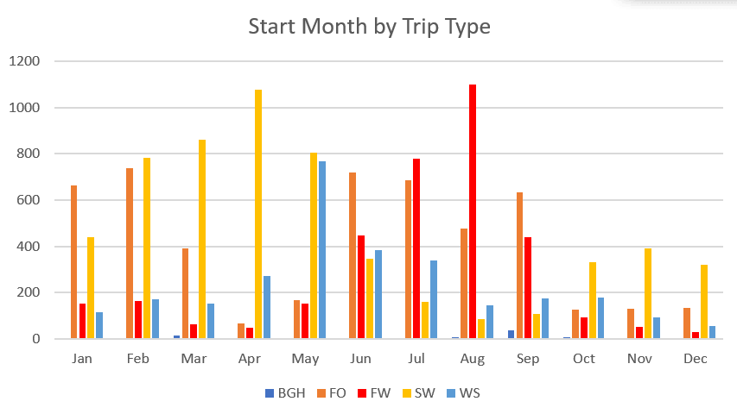
High Seasons for Types of Trips
Most trips start between May and September
Trip Type | Most Frequent Month
Saltwater Fishing | April
Freshwater Fishing | August
Freshwater Fishing-other | January - February and June - September
Wing shooting | May
Big Game Hunting | September

Slide 4
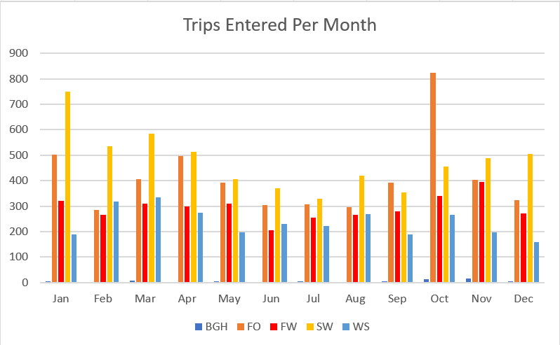
Patterns of Trip Bookings
Nearly half of trip of all types (47%) are booked October through December
Trip Type | Most Frequent Booking Month
Saltwater Fishing | January
Freshwater Fishing | Consistent year round
Freshwater Fishing-other | January, April, and October
Wing shooting | February - March (but mostly consistent year round)
Big Game Hunting | October - November

Slide 5
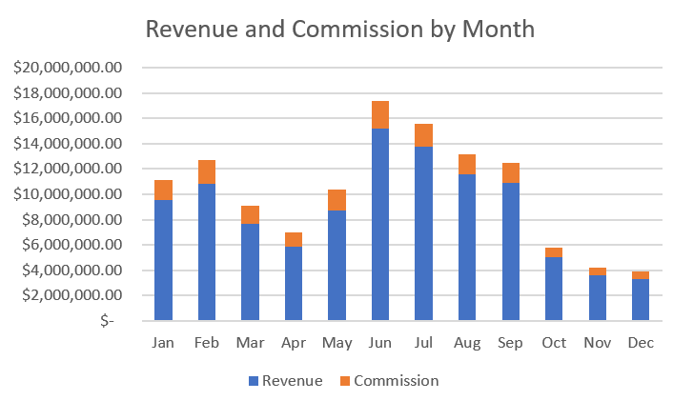
Revenues and Commission by Month
Most land sales occurred June through September, with a second smaller peak January through February
Top commissions followed a similar pattern, with the most commissions coming in May through August, with a second smaller peak also in January and February.

Slide 6
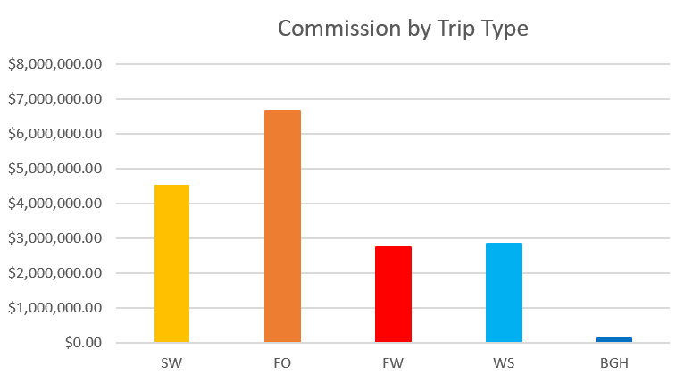
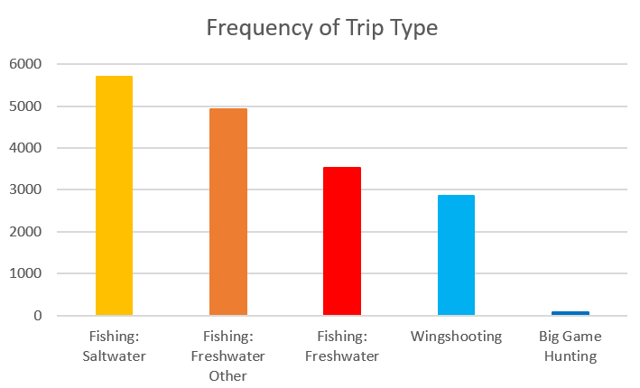
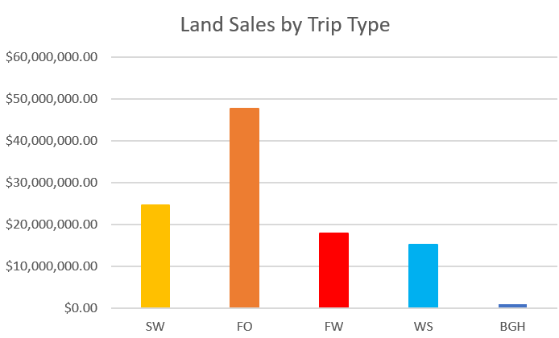
Frequency and Highest Earning Trip Types
While saltwater fishing trips were the most popular, the freshwater (other) fishing trips earned the most in commissions and land sales

Slide 7
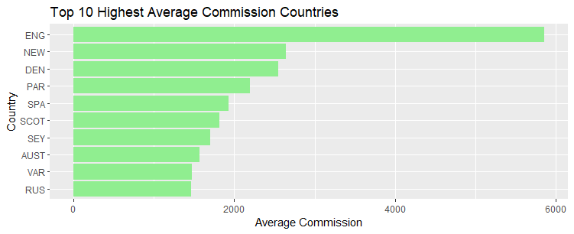
Top Commission-Earning Countries
England is an ideal target for market expansion.
New Zealand, Russia, and the Seychelles have the highest number of trips booked of those on this list.
Figure 10

Slide 8
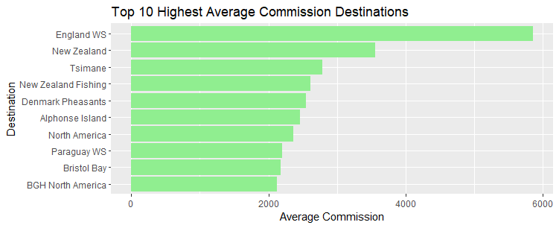
Top Commission-Earning Destinations
Many of these destination were not frequented as trips and may benefit from increased promotion.
Figure 10

Slide 9
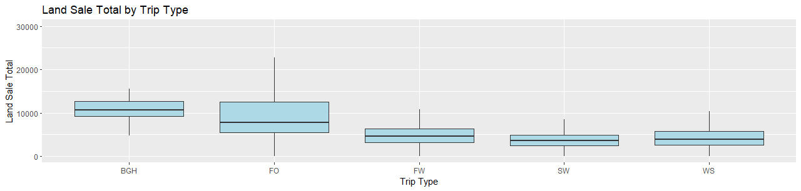
Land Sale Total - Different Trip Types
Freshwater (Other) is heavily right-skewed.
Freshwater and saltwater fishing data seems near-normal.
Figure 12. Note that some outliers have been left out to better scale the IQR

Slide 10
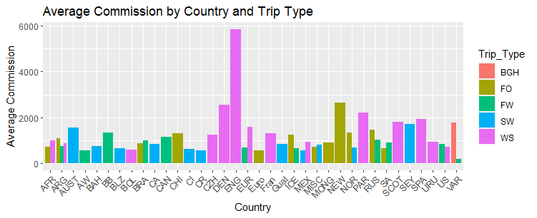
What Countries to Promote for each Type of Trip
Wing Shooting:
England, Denmark, Paraguay
Saltwater Fishing:
Seychelles, Australia, Guatemala
Freshwater Fishing:
Bristol Bay, Canada, Russia
Freshwater (Other):
New Zealand, Russia, Norway
Figure 13

Slide 11
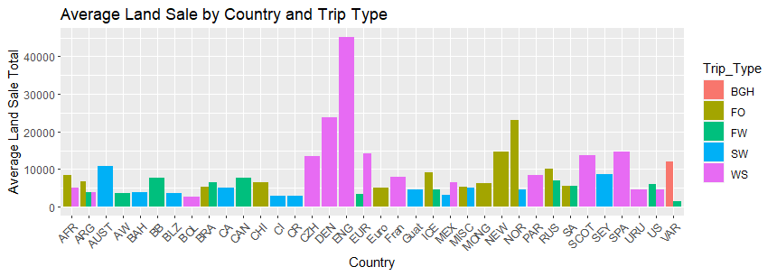
What to Promote - Land Sale Total
Wing Shooting:
England, Denmark, Paraguay
Saltwater Fishing:
Seychelles, Australia, Norway
Freshwater Fishing:
Various, Russia, Europe
Freshwater (Other):
New Zealand, Russia, Norway
Note the difference in rankings for total revenue and anticipated commission.
Figure 14

Slide 12
Insights | Recommendations
Sale Enhancements: Referral Packages, Seasonal Packages, Incentives/Loyalty Program, Targeted Promotions, and digital presence.
Promotional Efforts: (Customer Acquisition and Customer Engagement) should focus on highest commission trips, land sale opportunities, and customer preferences. For returning customers, implementing a loyalty program with seasonal offers and other incentives can lead to an increase in repeat bookings.
Focused marketing campaigns during the peak booking seasons such as specialized perks or discounts for the destinations that historically have high-commission rates to increase the amount of bookings at those destinations. Additional marketing campaigns can be used to improve the popularity of high-revenue and high-commission trips previously lacking in quantity.
By implementing these recommendations, we can improve sales performance and create long-term customer loyalty. These strategies aim to create a positive experience for each customer, leading to continued business growth and customer satisfaction.

Slide 13
Questions?
Joshua Noorily, Sari Prince, Navneet Sunderraman, Emily Overall

